Slide 1


Computational Intelligence (TC2027)

Slide 2
Unit 6 - Risk Management and Standards Framework (I)
Risk Fundamentals
Risk Assessment
Security Controls or Safeguards
Risk Monitoring

Slide 3
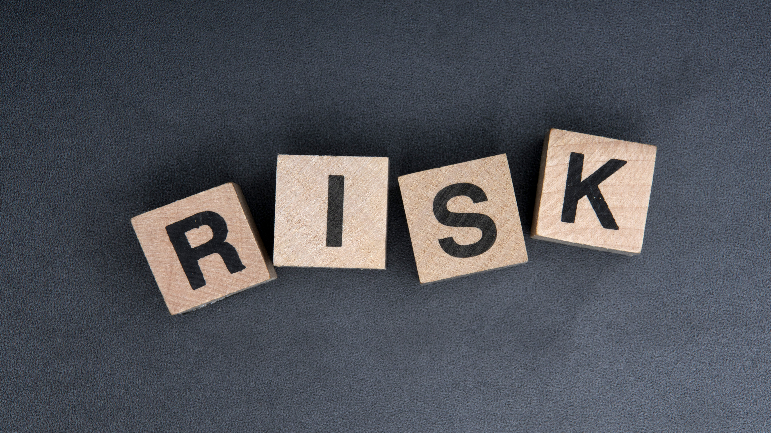
Risk Fundamentals

Slide 4
Ukraine Power Grid Cyberattack Autopsy
What assets do we need to protect?
How are those assets threatened?
Can all assets in the network be protected?
What is the value of each asset for my business?
Can the attack kill-chain used to perform the attack be predicted?
What can we do to counter those threats?
If the kill-chain cannot be predicted, in most cases, what can we do?
23 December 2015

Slide 5
Risk Management
Identify
Risk management is the identification, evaluation, and prioritization of risks (effect of uncertainty on objectives) followed by coordinated and economical application of resources to minimize, monitor, and control the probability or impact of unfortunate events or to maximize the realization of opportunities.
Risk Management
Control
Analyze
Monitor
Action
ISO/IEC Guide 73:2009 (2009). Risk management — Vocabulary. International Organization for Standardization.

Slide 6
Risk Components and Measures
Uncertainty, which can be measured via probabilities, is involved in all components.
Probabilities would be mostly conditional, requiring a more careful analysis.
CONDITION
(passive element)
POTENTIAL EVENT
PROBABILITY
CONSEQUENCE
(loss)
EXPOSURE
Risk Management is a systematic approach for minimizing exposure to potential losses.
IMPACT
TIME FRAME

Slide 7
From a Cyber Perspective….
VULNERABILITY
THREAT
EXPLOIT
CONDITION
(passive element)
POTENTIAL EVENT
CONSEQUENCE
(loss)

Slide 8
Risk Management
Risk Management is a systematic approach for minimizing exposure to potential losses.
Provides a disciplined environment for:
Continuously assessing what could go wrong
Determining which risks to address, and how (risk avoidance and mitigation strategy)
Implementing actions to address high-priority risks
Core Risk Management activities:
Assess risk (Risk Assessment);
Plan for controlling risk (Security Controls or Safeguards); and
Control risk - execute plan (Risk Monitoring).
Mappings can be done to OODA loop and PDCA cycle

Slide 9
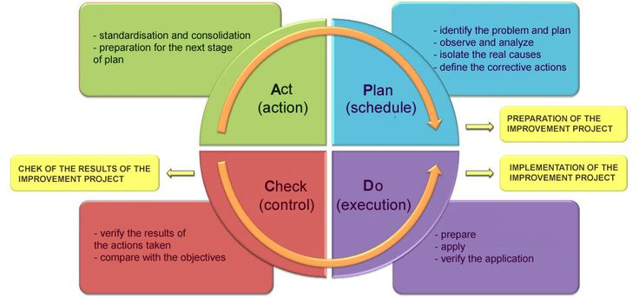
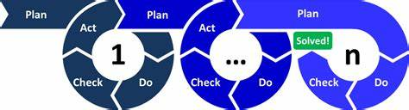
PDCA Cycle
Is an iterative four-step management method used in business for the control and continual improvement of processes and products;
Also known as the Deming circle/cycle/ wheel, Shewhart cycle, control circle/cycle, or plan–do–study–act (PDSA);
Its concept was based on the scientific method (Francis Bacon, 1620); and
The scientific method can be written as "hypothesis"–"experiment"–"evaluation“ or plan, do and check.

Slide 10

Risk Assessment

Slide 11
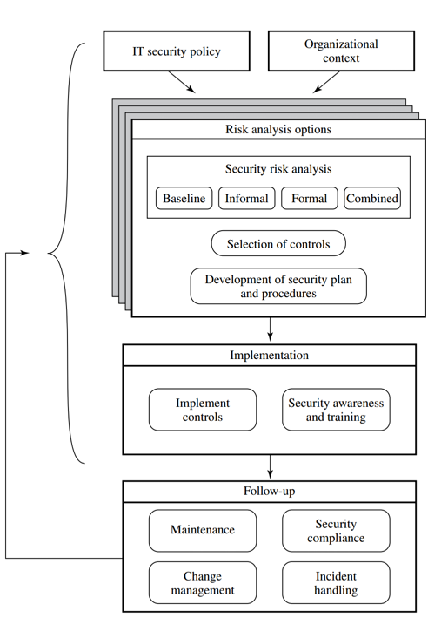
Risk Assessment
Risk Assessment: the overall process of hazard identification, risk analysis, and risk evaluation.
Risk Assessment Goal: evaluate hazards, then remove that hazard or minimize the level of its risk by adding control measures, as necessary. By doing so, you have created a safer and healthier workplace.
STALLINGS, William et al. Computer security: principles and practice. Upper Saddle River, NJ, USA: Pearson Education, 2012.
Overview of Risk Management*

Slide 12
Approaches to Risk Assessment (ISO 1335)
Baseline
Aims to implement a basic general level of security controls on systems using baseline documents, codes of practice, and industry best practice.
Use best practices, as CERT, NSA checklist, etc.
Informal
This analysis does not involve the use of a formal, structured process, but rather exploits the knowledge and expertise of the individuals performing this analysis.
The major advantage of this approach is that the individuals performing the analysis require no additional skills; however, some dimensions of risk can be missed.
Detailed Risk Analysis
This process involves several stages, including identification of assets, identification of threats and vulnerabilities to those assets, determination of the likelihood of the risk occurring and the consequences to the organization should that occur, and hence the risk the organization is exposed to.
Combined
Combines elements of the baseline, informal, and detailed risk analysis approaches.

Slide 13
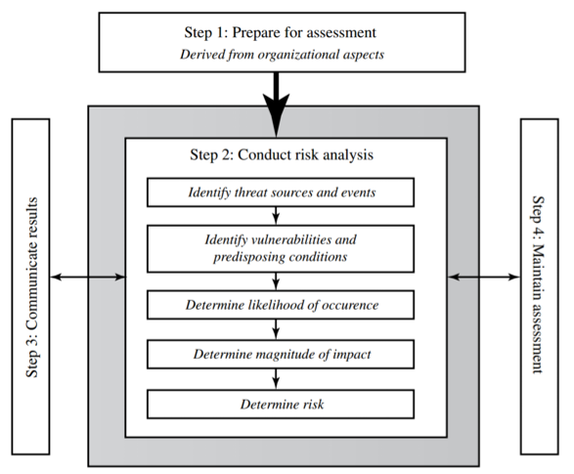
Risk Assessment Process
There are various national and international standards on risk analysis approach.
These include [ISO27005], [NIST12], and [ISO31000].
[ISO27005] ISO/IEC, “ISO/IEC 27005:2011—Information technology—Security techniques—Information security risk management,” 2011.
[NIST12] National Institute of Standards and Technology, Risk Management Guide for Information Technology Systems, Special Publication 800-30 Revision 1, September 2012.
[ISO31000] ISO, “ISO 31000:2009—Risk management—Principles and guidelines,” 2009
STALLINGS, William et al. Computer security: principles and practice. Upper Saddle River, NJ, USA: Pearson Education, 2012.

Slide 14
Risk Assessment Process - Example
STEP 1 - Context and System Characterization
A - Establishing the Context
B - Asset Identification
STEP 2 - Identification of Threats/Risks/Vulnerabilities
A - Threat Identification
B - Vulnerability Identification
STEP 3 - Analyze Risk
A - Analyze Existing Controls
B - Determine Likelihood
C - Determine Impact/Consequence
D - Determine Resulting Level of Risk
E - Document Risk
STEP 4 - Risk Treatment Strategies
A - Accept
B - Avoid
C - Transfer
D - Mitigate.

Slide 15
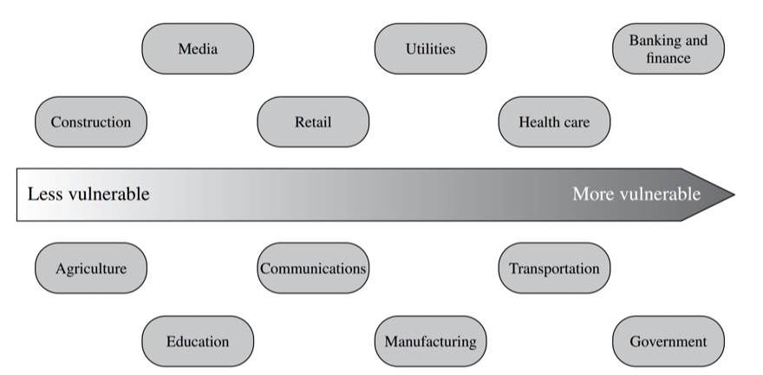
Step 1- Context and System Characterization A - ESTABLISHING THE CONTEXT
The process starts with the organizational security objectives and considers the broad risk exposure of the organization.
At this point, any relevant legal and regulatory constraints must also be identified.
Provides a baseline for the organization’s risk exposure and an initial indication of the broad scale of resources it needs to expend to manage this risk in order to successfully conduct business.
Spectrum of Organizational Risk (IDC 2000 report)

Slide 16
Step 1- Context and System Characterization A - ESTABLISHING THE CONTEXT
Senior management must define the organization’s risk appetite, the level of risk the organization views as acceptable.
The boundaries of this risk assessment are then identified.
This may range from just a single system or aspect of the organization to its entire IT infrastructure.
This will depend in part on the risk assessment approach being used. A combined approach requires separate assessments of critical components over time as the security profile of the organization evolves.

Slide 17


Step 1- Context and System Characterization B - ASSET IDENTIFICATION
The step where assets are identified and their values to the organization calculated.
A key element of this process step is identifying and interviewing the key-personnel.
Asset: “anything” that needs to be protected (tangible or intangible) because of its value to the organization and contribution to the successful attainment of the organization’s objectives.
Many of the standards listed previously include checklists of types of assets and suggestions for mechanisms for gathering the necessary information.

Slide 18
Step 2 - Identification of Threats/Risks/Vulnerabilities
The goal of this stage is to identify potentially significant risks to the assets listed.
This requires answering the following questions for each asset:
Who or what could cause it harm?
How could this occur?
Asset: A system resource or capability of value to its owner that requires protection.
Threat: A potential for a threat source to exploit a vulnerability in some asset,
which if it occurs may compromise the security of the asset and cause harm to the asset’s owner.
Vulnerability: A flaw or weakness in an asset’s design, implementation, or operation and management that could be exploited by some threat.
Risk: The potential for loss computed as the combination of the likelihood that a given threat exploits some vulnerability to an asset, and the magnitude of harmful consequence that results to the asset’s owner.

Slide 19
Step 2 - Identification of Threats/Risks/Vulnerabilities
A – THREAT IDENTIFICATION
A threat may be either natural or human-made and may be accidental or deliberate.

Slide 20




Step 2 - Identification of Threats/Risks/Vulnerabilities A – THREAT IDENTIFICATION
Motivation: Why would they target this organization; how motivated are they?
Capability: What is their level of skill in exploiting the threat?
Resources: How much time, money, and other resources could they deploy?
Probability of attack: How likely and how often would your assets be targeted?
Deterrence: What are the consequences to the attacker of being identified?

Slide 21
Step 2 - Identification of Threats/Risks/Vulnerabilities B – VULNERABILITY IDENTIFICATION
Try to answer this question: How could this occur?
Involves identifying flaws or weaknesses in the organizations.
Note that the mere existence of some vulnerability does not mean harm will be caused to an asset. There must also be a threat source for some threat that can exploit the vulnerability for harm.

Slide 22
Step 3 – Analyze Risk
The aim is to identify and categorize the risks to assets that threaten the regular operations of the organization.
Risk = (Probability of a threat to occur) * (Cost to organization)

Slide 23
Step 3 – Analyze Risk
Analyze existing Controls: Before the likelihood of a threat can be specified, any existing controls used by the organization to attempt to minimize threats need to be identified.
Security controls include management, operational, and technical processes and procedures that act to reduce the exposure of the organization to some risks by reducing the ability of a threat source to exploit some vulnerabilities.

Slide 24
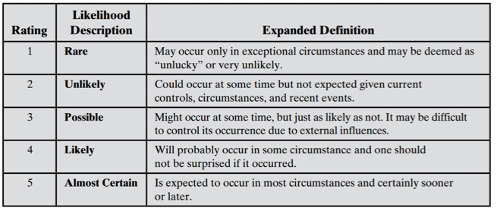
Step 3 – Analyze Risk
Determining the Likelihood: Having identified existing controls, the likelihood that each identified threat could occur and cause harm to some asset needs to be specified.

Slide 25
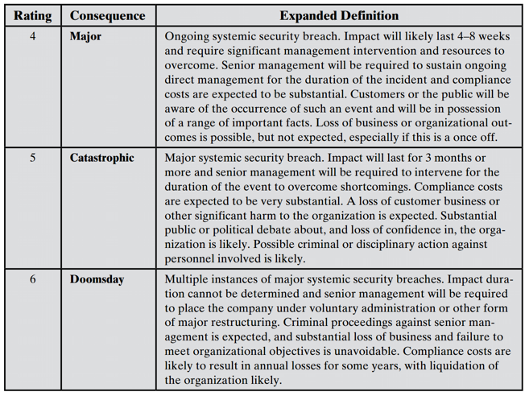
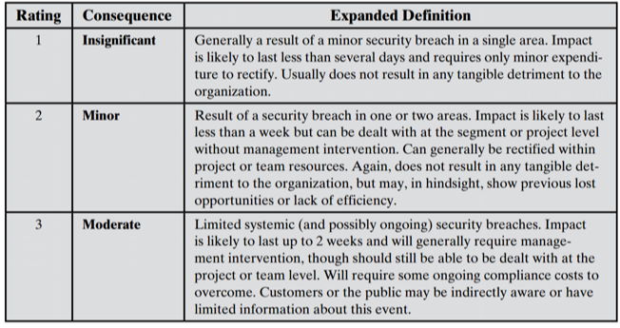
Step 3 – Analyze Risk
Determining the Impact / Consequence on Organization: The analyst must then specify the consequence of a specific threat eventuating. Note this is distinct from, and not related to, the likelihood of the threat occurring.

Slide 26
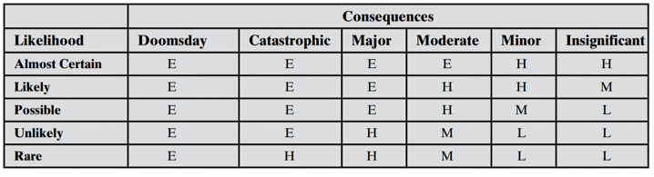
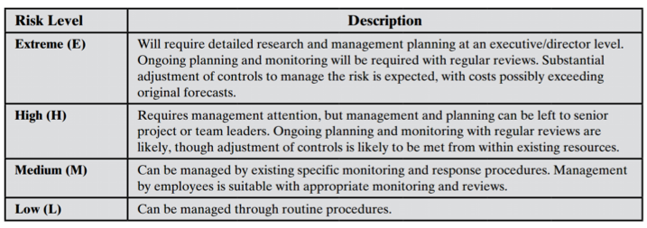
Step 3 – Analyze Risk
Determining Resulting Level of Risk: Once the likelihood and consequence of each specific threat have been identified, a final level of risk can be assigned.

Slide 27
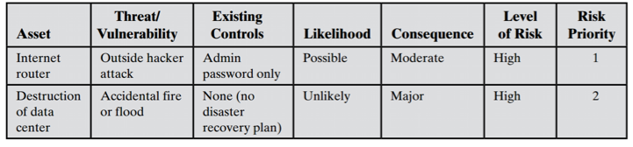
Step 3 – Analyze Risk
Document the Risk in the Risk Register: The results of the risk analysis process should be documented in a risk register.

Slide 28
Step 4 – Risk Treatment
Risk Treatment is the process of selecting and implementing of measures to modify risk.
Risk treatment measures can include avoiding, optimizing, transferring or retaining risk.

Slide 29
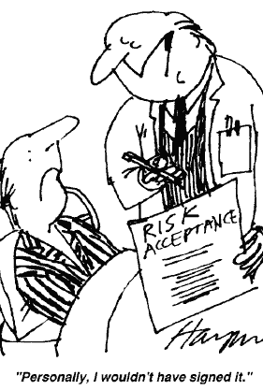
Step 4 – Risk Treatment - Strategies
Risk acceptance: Choosing to accept a risk level greater than normal for business reasons.
Management must then accept responsibility for the consequences to the organization should the risk eventuate.

Slide 30

Step 4 – Risk Treatment - Strategies
Risk avoidance: Not proceeding with the activity or system that creates this risk.
This usually results in loss of convenience or ability to perform some function that is useful to the organization.

Slide 31

Risk transfer: Sharing responsibility for the risk with a third party.
This is typically achieved by taking out insurance against the risk occurring, by entering a contract with another organization, or by using partnership or joint venture structures to share the risks and costs should the threat eventuate.
Step 4 – Risk Treatment - Strategies

Slide 32
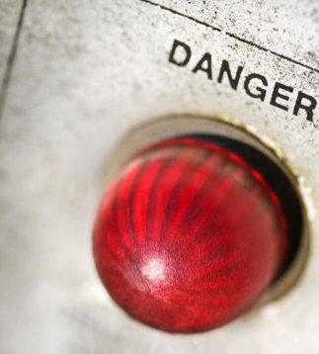
Step 4 – Risk Treatment - Strategies
Reduce consequence: By modifying the structure or use of the assets at risk to reduce the impact on the organization should the risk occur.
Examples include implementing an off-site backup process, developing a disaster recovery plan, or arranging for data and processing to be replicated over multiple sites.

Slide 33

Step 4 – Risk Treatment - Strategies
Reduce likelihood: By implementing suitable controls to lower the chance of the vulnerability being exploited.
These could include technical or administrative controls such as deploying firewalls and access tokens, or procedures such as password complexity and change policies.

Slide 34
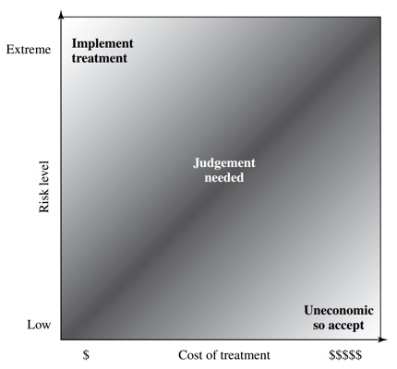
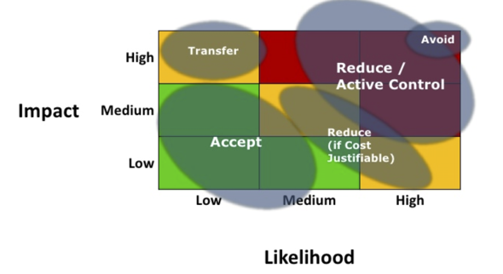
Step 4 – Risk Treatment - Strategies
European Union Agency for Cybersecurity (ENISA) – Risk Management Framework
https://www.enisa.europa.eu/topics/threat-risk-management/risk-management
STALLINGS, William et al. Computer security: principles and practice. Upper Saddle River, NJ, USA: Pearson Education, 2012.

Slide 35
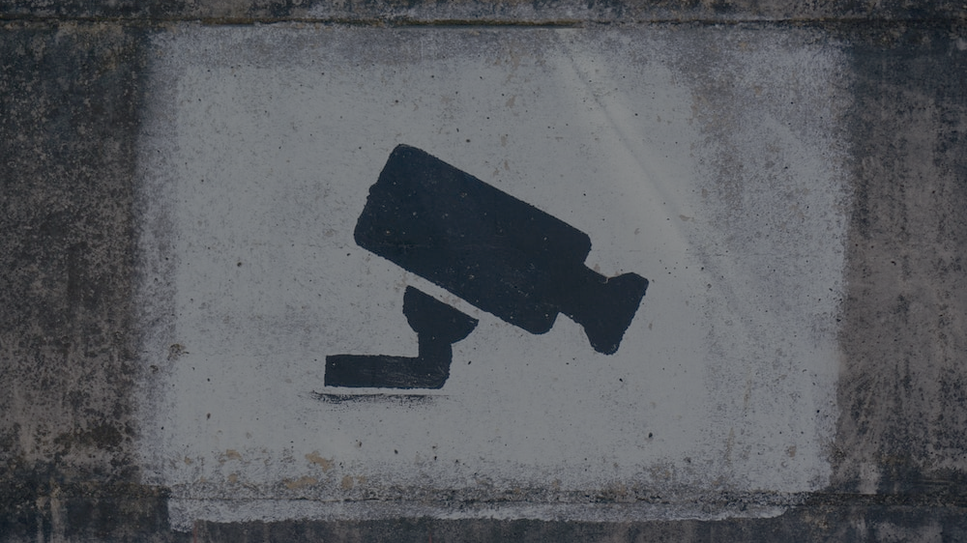
Security Controls or Safeguards

Slide 36
Security Controls or Safeguards
Control: An action, device, procedure, or other measure that reduces risk by eliminating or preventing a security violation, by minimizing the harm it can cause, or by discovering and reporting it to enable corrective action.
STALLINGS, William et al. Computer security: principles and practice. Upper Saddle River, NJ, USA: Pearson Education, 2012.
Overview of Risk Management*

Slide 37
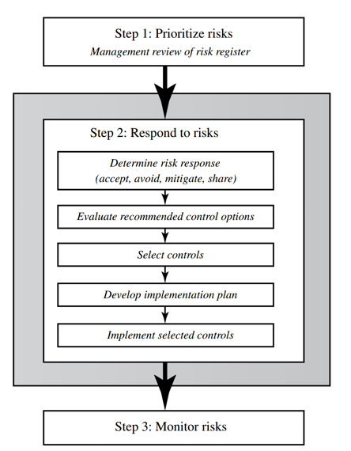
Security Controls or Safeguards
A risk assessment on an organization’s systems identifies areas needing treatment.
The next step on risk analysis options is to select suitable controls to use in this treatment.

Slide 38
Control’s Classifications
Management controls: Focus on security policies, planning, guidelines, and standards that influence the selection of operational and technical controls to reduce the risk of loss and to protect the organization’s mission.
Operational controls: Address the correct implementation and use of security policies and standards, ensuring consistency in security operations and correcting identified operational deficiencies.
Technical controls: Involve the correct use of hardware and software security capabilities in systems

Slide 39
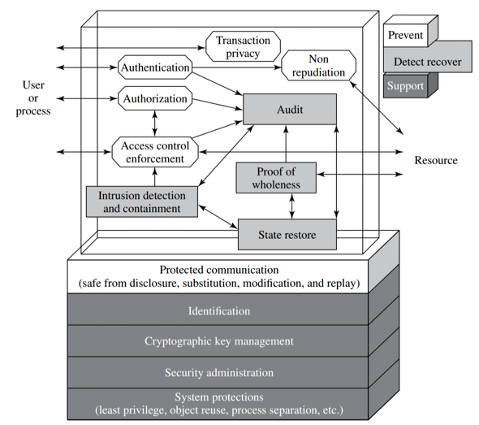
Control’s Classifications
Supportive controls: Pervasive, generic, underlying technical security capabilities that are interrelated with, and used by, many other controls.
Preventive controls: Focus on preventing security breaches from occurring, by inhibiting attempts to violate security policies or exploit a vulnerability.
Detection and recovery controls: Focus on the response to a security breach, by warning of violations or attempted violations of security policies or the identified exploit of a vulnerability and by providing means to restore the resulting lost computing resources.
STALLINGS, William et al. Computer security: principles and practice. Upper Saddle River, NJ, USA: Pearson Education, 2012.

Slide 40
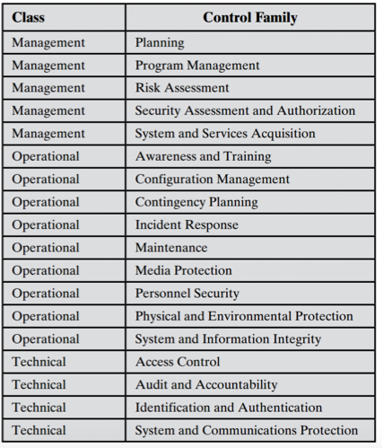
Types of Controls
Lists of controls are provided in several national and international standards, including ISO-27002, ISO-13335, and NIST SP800-53.
Example of Controls - NIST SP800-53

Slide 41

How do I select the appropriate control for my problem?
Technology: Some controls are only applicable to specific technologies, and hence these controls are only needed if the system includes those technologies.
Common controls: The entire organization may be managed centrally and may not be the responsibility of the managers of a specific system.
Public x Private Applications: The scope of application of such controls must be specified carefully.

Slide 42
How do I select the appropriate control for my problem?
Infrastructure controls: Physical access or environmental controls are only relevant to areas housing the relevant equipment.
Scalability issues: Controls may vary in size and complexity in relation to the organization employing them.
Risk assessment: Controls may be adjusted according to the results of specific risk assessment of systems in the organization, as we now consider.

Slide 43
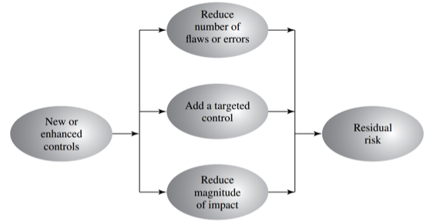
Residual Risk
The residual risk is the amount of risk or danger associated with an action or event remaining after natural or inherent risks have been reduced by risk controls.
STALLINGS, William et al. Computer security: principles and practice. Upper Saddle River, NJ, USA: Pearson Education, 2012.

Slide 44

Residual Risks are the risks that are expected to remain after the planned responses of risk has been taken, as well as those that have been deliberately accepted.
Secondary Risks are the risks that arise as a direct outcome of implementing a risk response.
PMBOOK, Guide. (2008). Newtown square, Pennnsylvania, USA: Project Management Insitute.

Slide 45
Controls Implementation
The implementation costs and resources used stay within identified bounds.
The controls are correctly implemented as specified in the plan, in order that the identified reduction in risk level is achieved.
The controls are operated and administered as needed.
Appropriate security awareness training for all personnel in an organization, along with specific training relating to systems and controls, is an essential component in implementing controls.

Slide 46
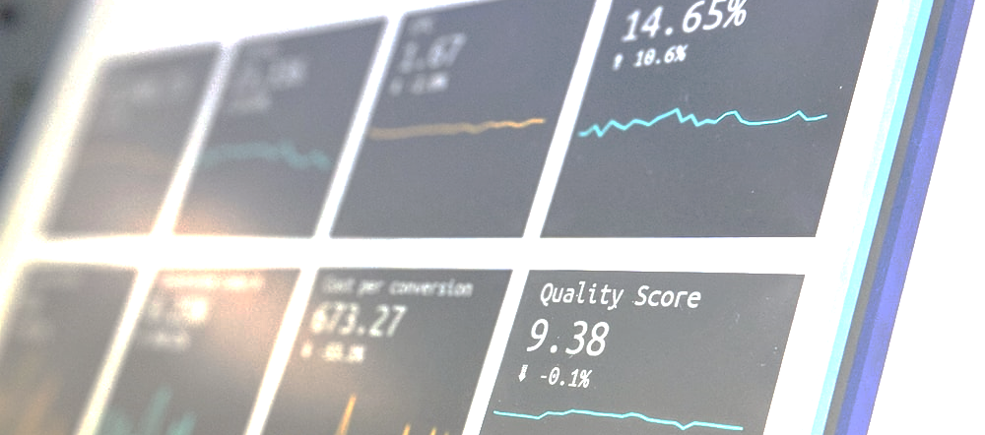
Risk Monitoring

Slide 47
Risk Monitoring
It is a cyclic process, constantly repeated to respond to changes in the IT systems and the risk environment.
STALLINGS, William et al. Computer security: principles and practice. Upper Saddle River, NJ, USA: Pearson Education, 2012.
Overview of Risk Management*

Slide 48
Maintenance
The first aspect concerns the continued maintenance and monitoring of the implemented controls to ensure their continued correct functioning and appropriateness.
The maintenance tasks include ensuring that:
Controls are periodically reviewed to verify that they still function as intended.
Controls are upgraded when new requirements are discovered.
Changes to systems do not adversely affect the controls.
New threats or vulnerabilities have not become known

Slide 49
Security compliance checking is an audit process to review the organization’s security processes.
The goal is to verify compliance with the security plan.
The audit may be conducted using either internal or external personnel.
It is generally based on the use of checklists, which verify that the suitable policies and plans have been created, that suitable controls were chosen, and that the controls are maintained and used correctly.

Slide 50
Change management is the process used to review proposed changes to systems for implications on the organization’s systems and use.
Configuration management is concerned with specifically keeping track of the configuration of each system in use and the changes made to each. This includes lists of the hardware and software versions installed on each system.

Slide 51

Incident handling is a term describing the activities of an organization to identify, analyze, and correct hazards to prevent a future re-occurrence.
Detecting potential security incidents;
Sorting, categorizing, and prioritizing incoming incident reports;
Identifying and responding to breaches in security; and
Documenting breaches in security for future reference.

Slide 52
Detecting Incidents
Security incidents may be detected by users or administration staff who report a system malfunction or anomalous behavior through manually reports or by automated tools.
System integrity verification tools
Log analysis tools
Network and host intrusion detection systems (IDS)
Intrusion prevention systems

Slide 53
Responding Incidents
Taking action to protect systems and networks affected or threatened by intruder activity
Providing solutions and mitigation strategies from relevant advisories or alerts
Looking for intruder activity on other parts of the network
Filtering network traffic
Rebuilding systems
Patching or repairing systems
Developing other response or workaround strategies

Slide 54
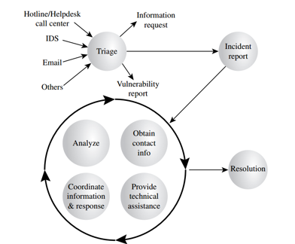
Incident-handling life cycle

Slide 55
Unit 6 - Risk Management and Standards Framework (I)
Risk Fundamentals
Risk Assessment
Security Controls or Safeguards
Risk Monitoring

Slide 56
Computational Intelligence (TC2027)

